Slide 1

Revolutionizing Visitor Management with Our Innovative Software Solution
CECS3210-80
José Rosado Gaitán 126996
Daniel Ovalle Cabral 103841
Alexander A. Yodice 122268
JAD TECHNOLOGIES

Slide 2

About JAD
We are a group of coding students who are passionate about software development. With a shared love for technology and a strong desire to learn, we come together to explore coding and create impactful projects. Our group includes students from diverse backgrounds, each with unique skills and perspectives. We constantly push ourselves to grow, learn new programming languages, and improve our coding abilities in different frameworks.

Slide 3
Revolutionizing Visitor Management with Our Innovative Software Solution
INTRODUCTION
At Jad Technologies, we understand the importance of security and efficiency in a business. We know that effective visitor management is critical not only for security purposes, but also to ensure a welcoming and professional experience for your guests.
However, we have noticed that many businesses still do not have a digital system or use outdated and inefficient systems to manage and track visitors, often leading to disorganized data, longer wait times, and potential security risks.
That is why we have developed our innovative Visitor Management System, a software solution designed to streamline the process of monitoring and managing visitors in your company. Today, we are excited to show you its main features and benefits.

Slide 4
The Challenges of Traditional Visitor Management
-Manual Data Entry: Manual logbooks are not only time consuming but also prone to human error. Incorrect or incomplete entries could lead to significant problems, including security risks.
-Privacy Concerns: Visitor information in a paper-based system can be viewed by anyone, which is a clear violation of privacy regulations.
-Difficult to Track Visitor History: Paper records make it incredibly difficult to retrieve historical visitor data, which is critical in case of emergencies or audits.
-Poor Visitor Experience: Having to wait for tickets to be manually registered can be frustrating for visitors and makes a less than professional first impression of your business.
Loss of Productivity: Administrative staff spend a lot of time managing visitor records, taking time away from other important tasks

Slide 5
Some Advantages of Visitor Registration SOFTWARE
- Process Automation: Our software automates the registration process, eliminating human errors and saving valuable time.
-Data Security: Visitor data is stored securely in an encrypted database.
- Increased Security: Verifies and records visitor details in real time, increasing the overall security of the building.
- Visitor History: Allows quick and easy access to historical visitor records for future reference or auditing.
- Visitor Experience: Enhance the visitor experience with a quick and seamless check-in process.
- Improve Productivity: Free up administrative staff to focus on more important tasks.

Slide 6
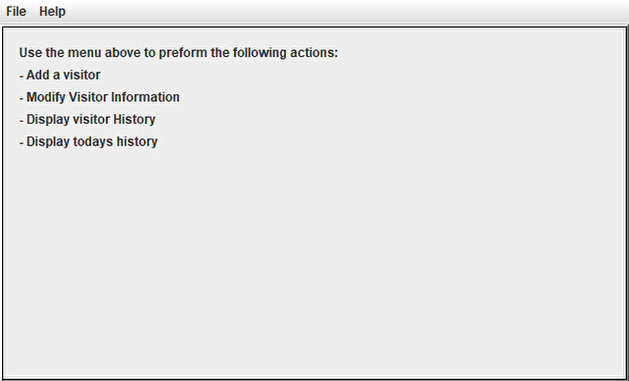
DEMONSTRATION

Slide 7
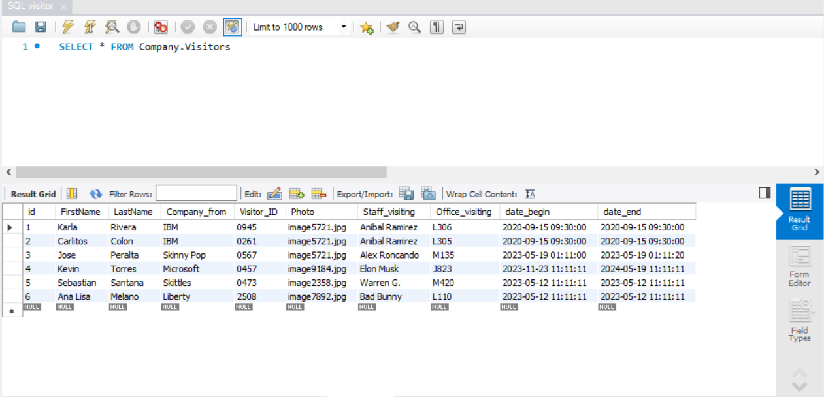
Here's an example of what a Database would look like:

Slide 8
Company Overview

Slide 9
Our competition
Jad technologies
competitors
Our product is priced below that of other companies on the market​
Design is simple and easy to use, compared to the complex designs of the competitors​
Affordability is the main draw for our consumers to our product​
Company A​ Product is more expensive​
Companies B & C ​ Product is expensive and inconvenient to use​
Companies D & E​ Product is affordable, but inconvenient to use

Slide 10
SUMMARY
In today's fast-paced, security-conscious world, it's more important than ever to know who's coming and going from your company premises. With our Visitor Registration System, you can simplify visitor tracking, improve your security, and create a more professional image for your business. Now is the time to take the next step.
Our team at JAD Technologies is ready to work with you to implement this solution and transform the way you manage visitors. Don't let another day go by with an outdated or non-existent visitor management system. Contact us today and let us help you improve your visitor management, security and efficiency. After all, a secure business is a successful business.

Slide 11
Thank you
Daniel Ovalle
787-123-4567​
Daniel.Ovalle@jadtechnologies.com​
www.jadtechnologies.com​

